Slide 1

CMR TECHNICAL CAMPUS
UGC(Autonomous)
Kandlakoya , Medchal Road, Hyd – 501401
Department of CSE(AI&ML)
Major Project On
Agro Connect
(Connecting the Roots of Commerce: From Soil to Shelf)
SDG - 2 (Zero Hunger), SDG - 8 (DECENT WORK AND ECONOMIC GROWTH)
Under the Guidance of: Team Members:
Mr. S. KIRAN T. Bhoopesh Kumar - 227R1A7362
Assistant Professor of CSE(AI&ML) M. Srishanth - 227R1A7347
J. Jeevan Kumar - 227R1A7330
Batch - A18

Slide 2
Table Of Contents
Introduction
Abstract
Existing System
Disadvantages
Proposed System
Advantages
System Architecture
Uml diagram
Software Requirements
Hardware Requirements
Conclusion

Slide 3
Introduction
The Heart of Our Economy: Agriculture
The agricultural sector is fundamental to our survival and economy, yet it operates on outdated, inefficient systems.
Key players—farmers and buyers—are disconnected, leading to lost value and opportunity at every step.
The core problem: A fragmented supply chain where farmers lack access to essential resources profitable markets (buyers).
Our Vision: To create a single, unified digital ecosystem that empowers every participant in the agricultural value chain, from the soil to the shelf.

Slide 4
ABSTRACt
AgroConnect is an online platform that bridges the gap between farmers and wholesale buyers by creating a transparent, direct-to-market ecosystem. Farmers can list their fresh produce and connect with verified wholesalers and retailers, eliminating middlemen and securing fair prices. The platform ensures secure transactions, builds trust through ratings and reviews, and offers real-time market visibility to streamline the buying and selling process. By simplifying distribution and improving profitability, AgroConnect promotes a more efficient, transparent, and sustainable agricultural supply chain..

Slide 5
EXISTING SYSTEM
. The Sales Process:
  After harvest, farmers sell to local commission agents or middlemen because they lack access to larger markets.
  These middlemen consolidate produce and transport it to a central wholesale market (mandi).
  Wholesalers and retailers then purchase from these middlemen, often with little to no information about the produce's origin.
Key Characteristics:
  Hyper-Localized: Opportunities are limited to one's immediate geography and social circle.
  Relationship-Dependent: Success depends on personal connections, not merit or efficiency.
  No Centralized Information: Pricing and demand,

Slide 6
DISADVANTAGES
For Farmers:
  Price Exploitation: Forced to accept low, non-negotiable prices from powerful middlemen.
  Limited Opportunity: Trapped in a cycle of dependency with limited options for growth.
  High Financial Risk: No guarantee of a buyer or fair payment after a full season of labor.
For Wholesalers & Retailers:
  No Traceability: The origin, quality, and farming practices of the produce are a complete mystery.
  Inflated Costs: Multiple layers of middlemen drive up costs without adding value.
  Unreliable Supply Chain: Sourcing consistent quality and quantity is a constant challenge.

Slide 7
PROPOSED SYSTEM
Core Functionality:
  Produce Marketplace: A wholesale market where farmers list their upcoming harvests, and buyers can browse, negotiate, and place bulk orders directly.
Key Features That Power the System:
  Verified Profiles for all users to build a foundation of trust.
  Secure Payment Gateway with Escrow to protect both buyers and sellers.
  Rating & Review System to reward quality and reliability.

Slide 8
ADVANTAGES
For Farmers (Empowerment & Profit):
  Direct Market Access: Sell to a nationwide network of buyers and command fair market prices.
  Maximum Profitability: Eliminate intermediary fees and dramatically increase your income.
  Build Your Reputation: A strong rating becomes your most valuable asset.
For Wholesalers (Transparency & Efficiency):
  Complete Traceability: Know the exact farm, farmer, and practices behind your produce.
  Reliable Sourcing: Plan future inventory by viewing upcoming harvests and farmer ratings.
  Cost Savings: Purchase directly from the source, cutting out layers of unnecessary markups.

Slide 9
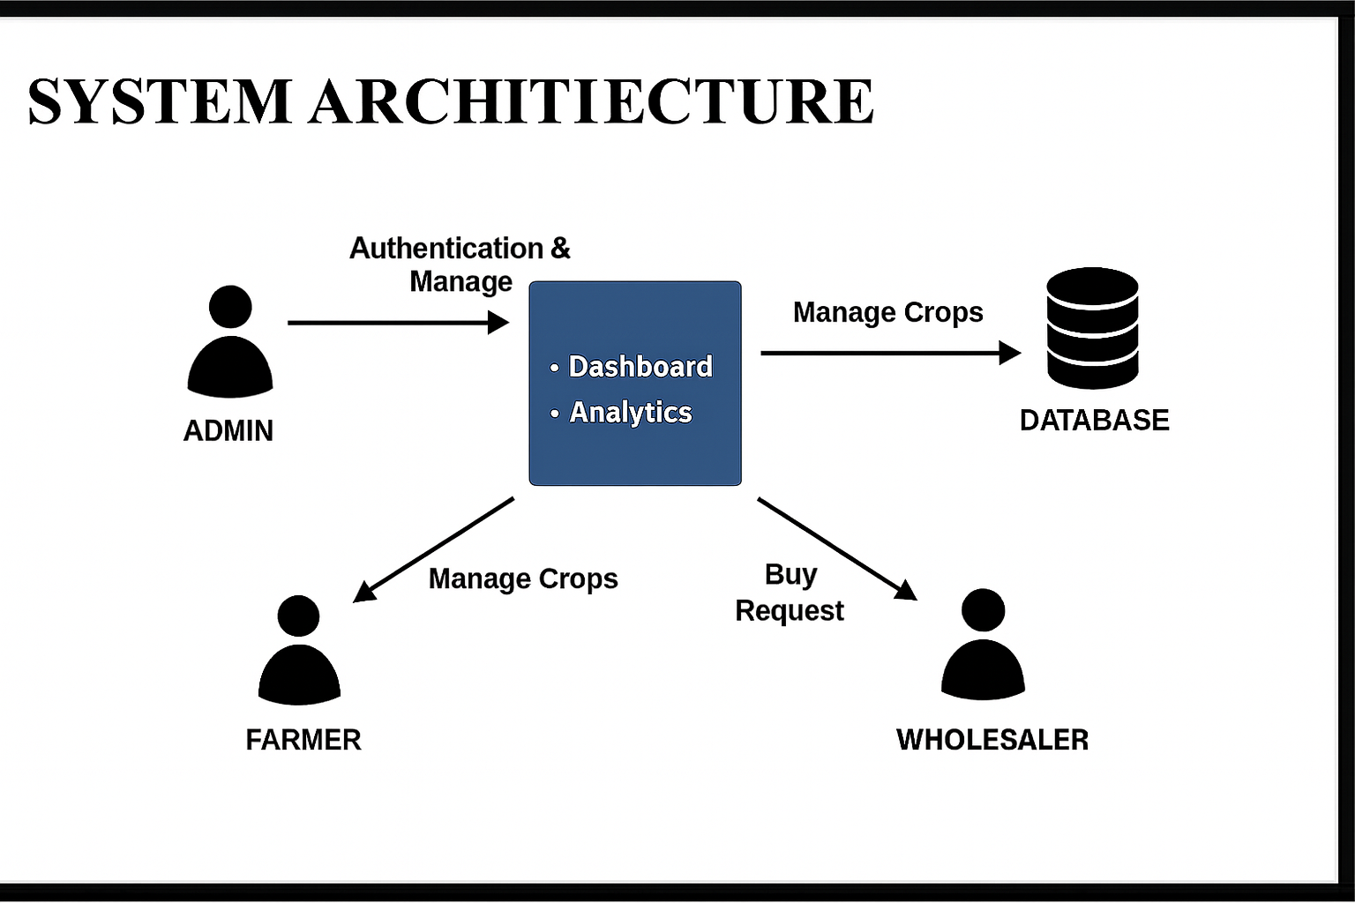

Slide 10
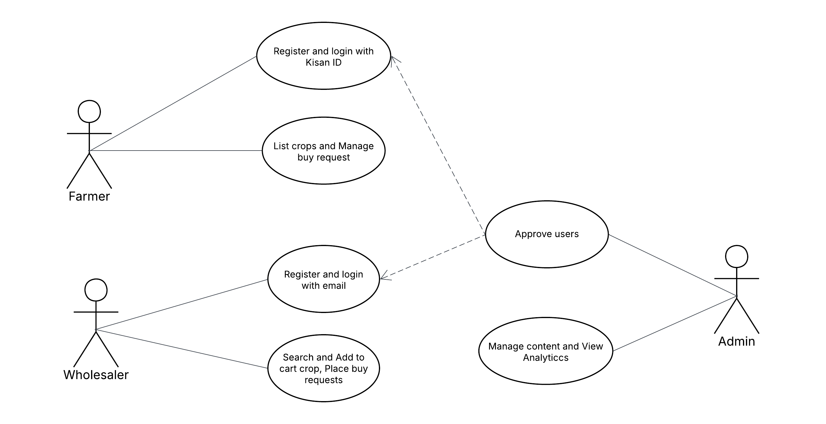
use case diagram
‘

Slide 11
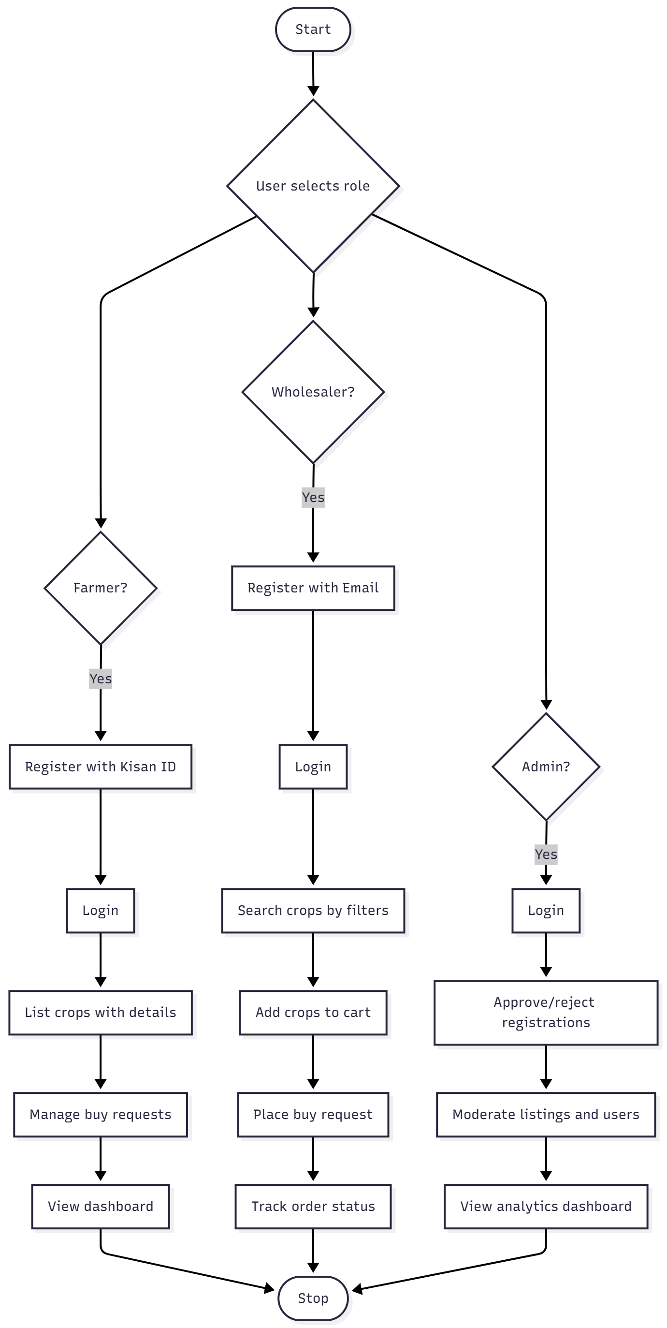
Activity diagram
‘

Slide 12
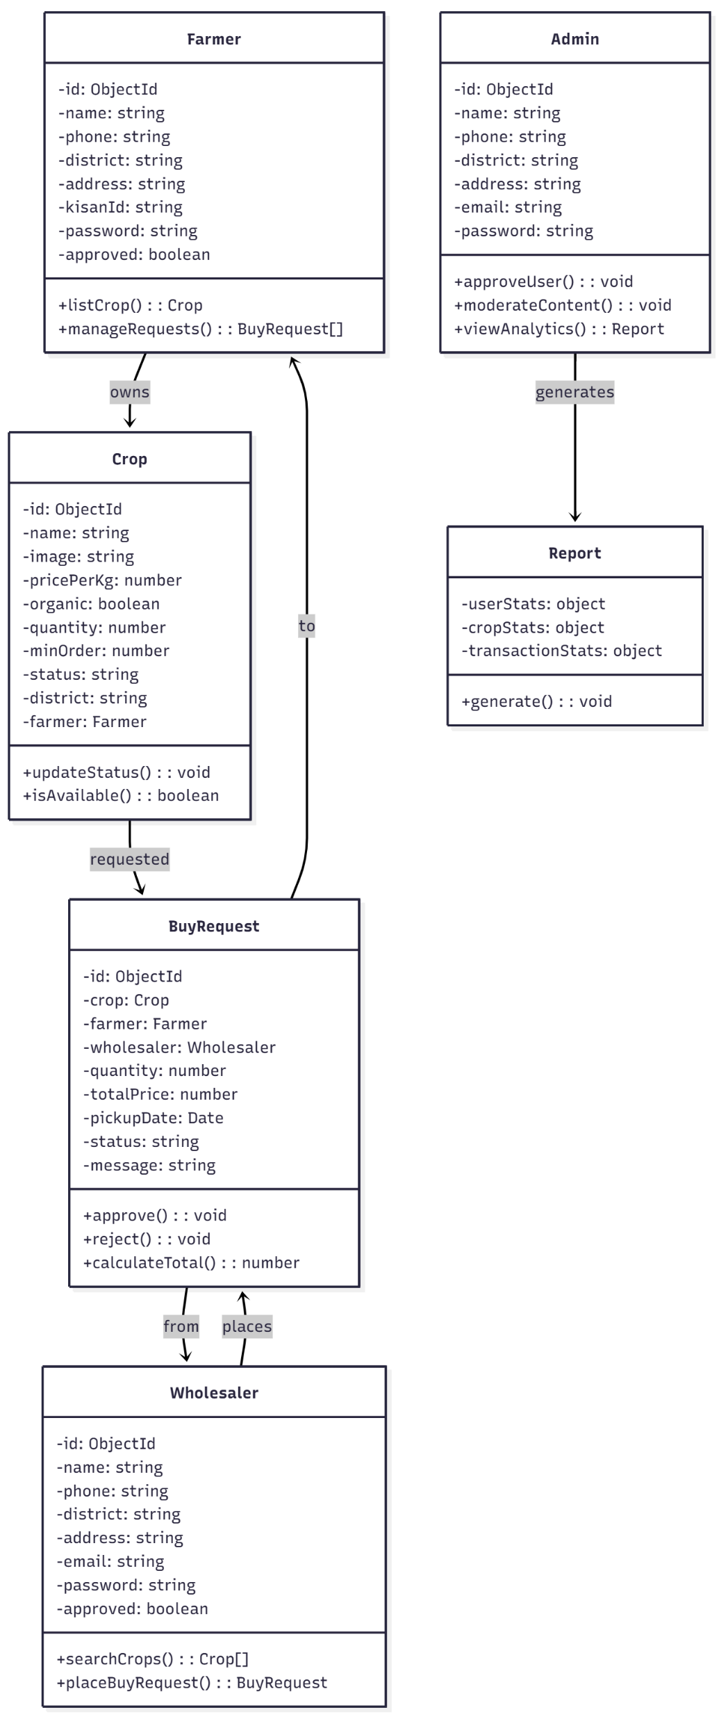
class diagram
‘

Slide 13
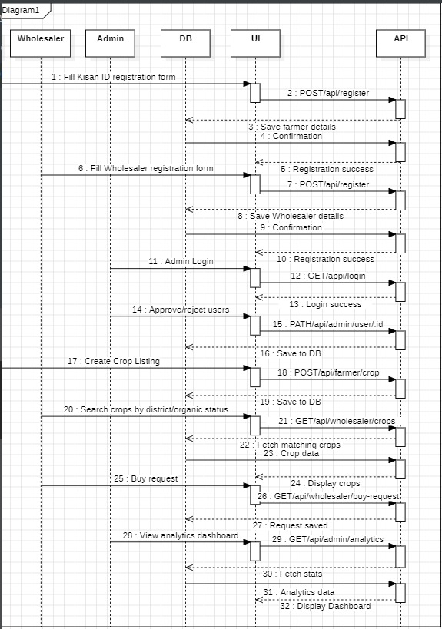
sequence diagram
‘

Slide 14
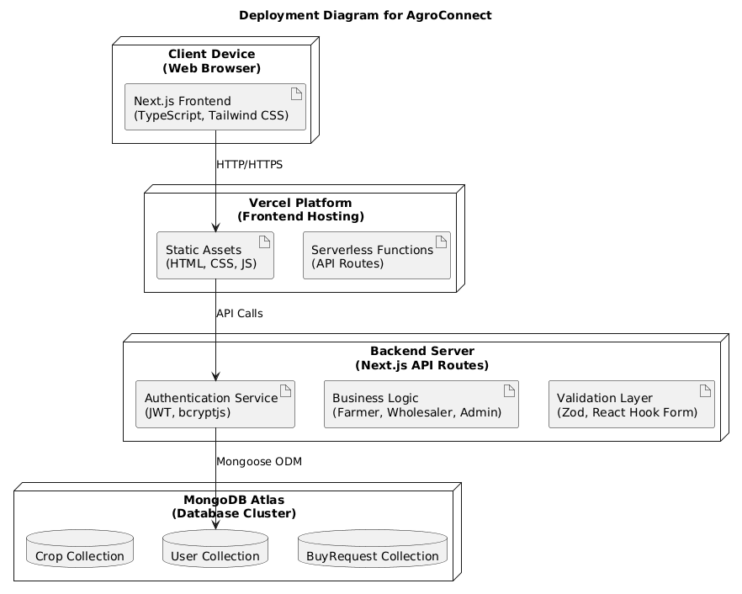
Deployment diagram
‘

Slide 15
SOFTWARE REQUIREMENTS
Operating System : Windows 10/11, Ubuntu 20.04, or macOS
Frontend : HTML, CSS, Next.js(to build user interface)
Backend : Node.js, Express.js
Database : MongoDB
Dev Tools: VS Code, Git & GitHub(for version control & project sharing)
HARDWARE REQUIREMENTS
CPU(Processor) : Intel Core i3 (8th Gen) / AMD Ryzen 3
RAM : 4 GB
Storage : 250 GB HDD/SSD
Display : 1024×768 resolution monitor
Network : 5 Mbps or higher internet

Slide 16
conclusion
Unifies the Agricultural Ecosystem: AgroConnect bridges the gap between farmers, and buyers by offering a centralized digital platform for land produced sales.
Boosts Profitability & Efficiency: By eliminating middlemen, it empowers farmers to increase profits while buyers benefit from reduced costs and greater supply chain transparency.
Trust-Based Transactions: Secure payments, digital contracts, and user ratings promote reliable, transparent, and risk-free interactions among all stakeholders.
Drives Sustainable Growth: The system modernizes agriculture through technology, encouraging better resource use, expanding market access, and laying the foundation for a resilient future in farming.

Slide 17
THANK YOU!

